Slide 1
RPA INTRODUCTION

Slide 2
Module No 1
RPA INTRODUCTION

Slide 3
Learning Objectives
Basic knowledge of RPA
Market Leading RPA Tools.
RPA Tools (UiPath, AA and Blue Prism) overview
Automation Developers Roles & Career Path
Trends & Future -Risks & Challenges
Set Up Your Machine for Learning…

Slide 4

Robotic Process Automation (RPA)
Robotic Process Automation is the technology that allows anyone today to configure computer software Robot, or a “robot” to mimic the actions of a human interacting within digital systems to execute a business process.
RPA robots utilize the user interface to capture data and manipulate applications just like humans do. They interpret, trigger responses and communicate with other systems in order to perform on a vast variety of repetitive tasks.
A third of organizations (33%) are currently using RPA primarily to improve the quality of their processes. This is followed by reducing operating costs and accelerating processes (24% and 23% respectively).

Slide 5
How does Robotic Process Automation work?
RPA robots are capable of mimicking many–if not all–human user actions.
It allow you log into applications, move files and folders, copy and paste data, fill in forms, extract structured and semi-structured data from documents, scrape browsers, and more.
RPA is also non-intrusive in nature and leverages the existing infrastructure without causing disruption to underlying systems
Works with Legacy System such as Mainframe etc.

Slide 6
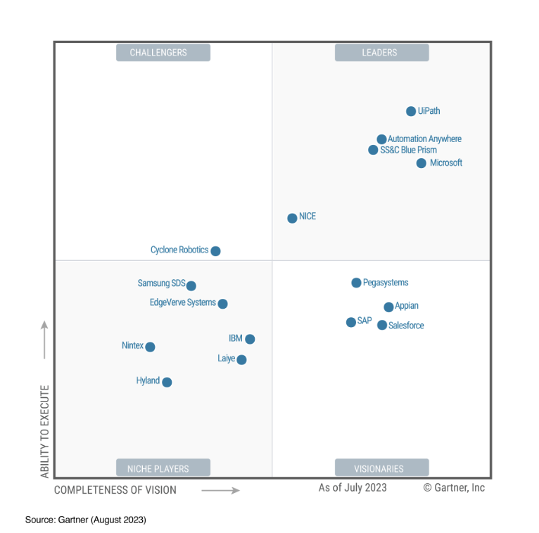
What Gartner Says..

Slide 7

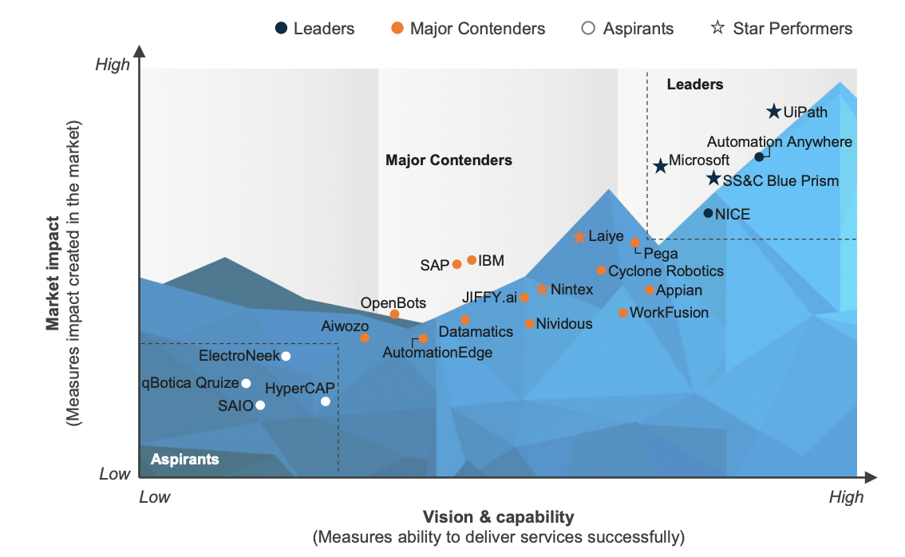
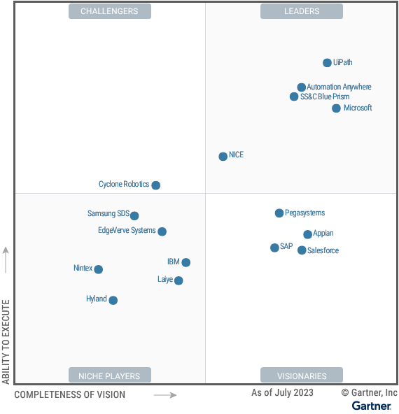
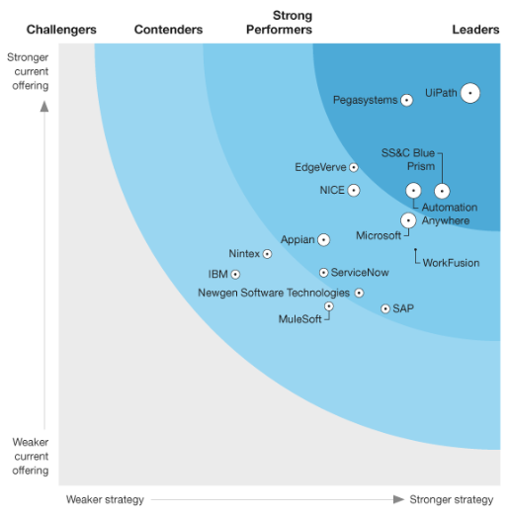
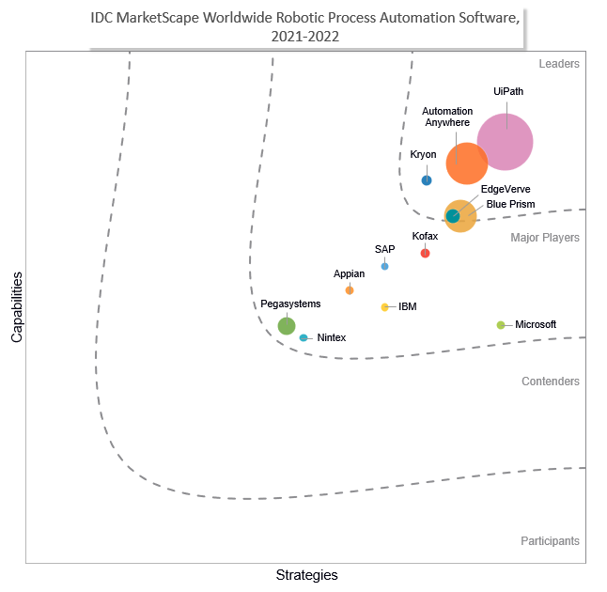
Top RPA Tools
Gartner
Forrester
IDC
Everest
Best in-class product vision / strategy for AI-powered automation, brand awareness, and market impact
Gartner and Forrester, 2023; other reports, 2022
Notes:
Of course, that’s our opinion and its only one. All the leading analysts agree with us however. All 4 leading analyst firms in the industry recognize UiPath as a leader in their various automation reports for best in-class product vision / strategy for AI-powered automation, brand awareness, and market impact

Slide 8
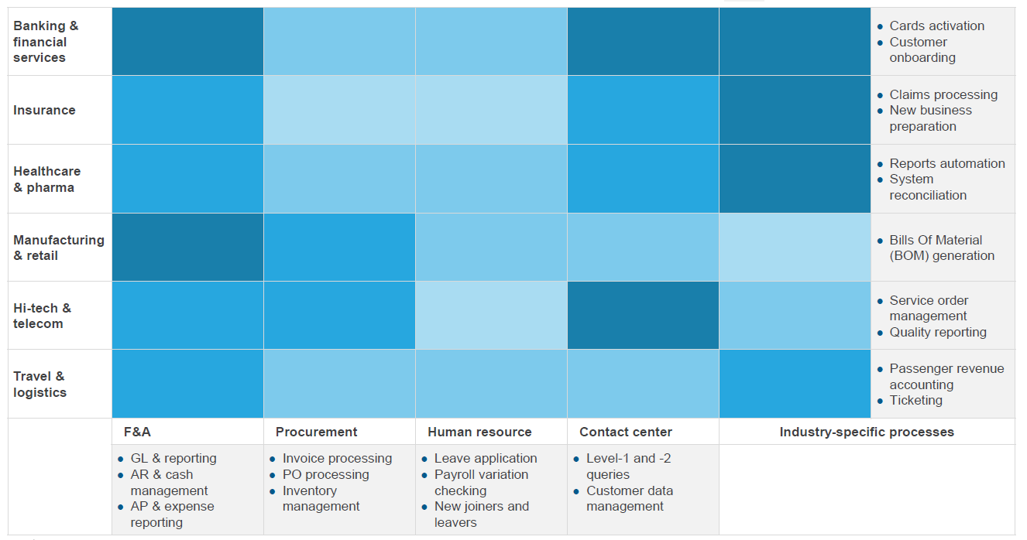
RPA Adoption Potential by Industry and Function

Slide 9

Introduction to UiPath
UiPath is a Robotic Process Automation tool that is used to automate repetitive/redundant tasks without human intervention. The tool has a simple drag and drop UI.
This tool offers various editions to support different types of users and comes with an active community to resolve issues.
UiPath RPA is a high-level platform dedicated to providing seamless automation of data entry on any web form & desktop application. It supports Excel and provides SAP and Citrix integration. Start easy and fast with the built-in recorder that reads and replays your actions on the screen.
It is founded in the year 2005 by the Romanian entrepreneurs Daniel Dines and Marius Tirca. It is used to automate boring repetitive tasks.
In December 2020, the company filed confidentially for an initial public offering, and became public on April 21, 2021.

Slide 10



AI at work: the Business Automation Platform
Discover
Identify the highest-ROI opportunities for continuous process optimization and automation using the power of AI
Process Mining
Task Mining
Communications Mining
Idea capture & management
Automate
Rapidly build AI-powered automation that seamlessly collaborates with people and systems to transform every facet of work
UI + API AUTOMATION
LOW-CODE DEVELOPMENT
GENERATIVE AI
& EXPERIENCES
Intelligent DOCUMENT processing & SPECIALIZED AI
Process Orchestration​
Operate
Establish an enterprise-grade foundation to run and optimize a ​mission-critical automation program at high scale
REAL-TIME & TREND
Analytics
Continuous testing
Unified Management & Governance
Cloud-FIRST flexibility
Your People
Your Applications
Your Processes
Systems of record | Communications and collaboration | Personal productivity​
Notes:
You have business transformation to drive - profitable growth, cost transformation, employee engagement and customer experience improvements. But operating more efficiently and innovating more effectively don’t just happen. Turning them into [transformative] reality means landing them through the vast array of processes across your business applications and the work your people do.
That’s what the UiPath Business Automation Platform does for you. It’s a comprehensive, enterprise-ready platform that connects your people, processes and applications so you can implement the process change that drives true transformation, quickly.
Of course, we’re not the only ones making this claim of being transformation accelerators. But look at the platform capabilities. The novel heart of the UiPath Automation Platform removes some of the biggest blockers in process transformation. UI and API automation in combination mean your core processes can run with the speed and reliability of API-based integration, but UI Automation can go the last mile to truly capture, automate and simplify the work of each individual person in those processes. And around that is a rich, integrated array of AI, test, IDP – or, because the platform is open, you can integrate with your own or 3rd party options.
In fact, wherever the work goes, UiPath goes. Through the data flows, through what people do (and shouldn’t have to), through every technology and every process—old and new. Like a nervous system exchanging signals and creating pathways between different parts of the organization, enabling everything to move faster and more efficiently together. Enabling your organization to operate and innovate at the pace of today —and tomorrow’s—business.
The discovery layer enables you to continuously watch business processes, watch the work, understand how it actually gets done—not just within an Oracle or an SAP system, but all-across: from email, to PDFs, to Excel spreadsheets, through multiple SaaS systems and traditional legacy systems as well—to discover issues to mitigate and remediate, and high-ROI areas to automate.
#The only platform with task, process, and communications mining capabilities and a complete process ideation capability
Then to efficiently and reliably automate them with the automate layer. With powerful API integration in addition to UI emulation, long-running workflows and easy human-robot handoffs, the ability to seamlessly use AI/ML models and skills, to seamlessly process information and extract understanding from documents and communications.
#The only integrated platform for delivering unified automation via UI and API with native integrated AI including intelligent document processing
And finally, to operate it all as a compliant, cost-effective, integrated platform. With analytics to track, measure, and manage automation performance, continuous testing to effortlessly ensure automation quality (and more generally the quality of any of your application development efforts), unified management and governance - so that you know the whole thing is compliant with your desired IT and security policies; and, of course, you can deploy the complete, cloud-native platform however you want, whether SaaS or self-hosted, for maximum flexibility—cloud-native all the way.
#Scale and governance to support the largest automation programs in the world
#Only test platform with production-grade automation, AI, security and governance

Slide 11
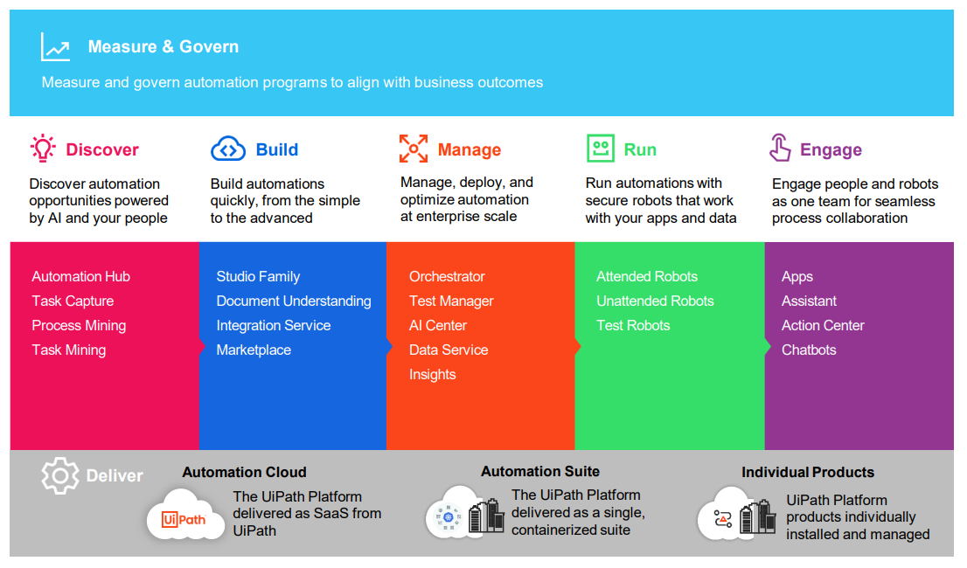
Various UiPath Products

Slide 12
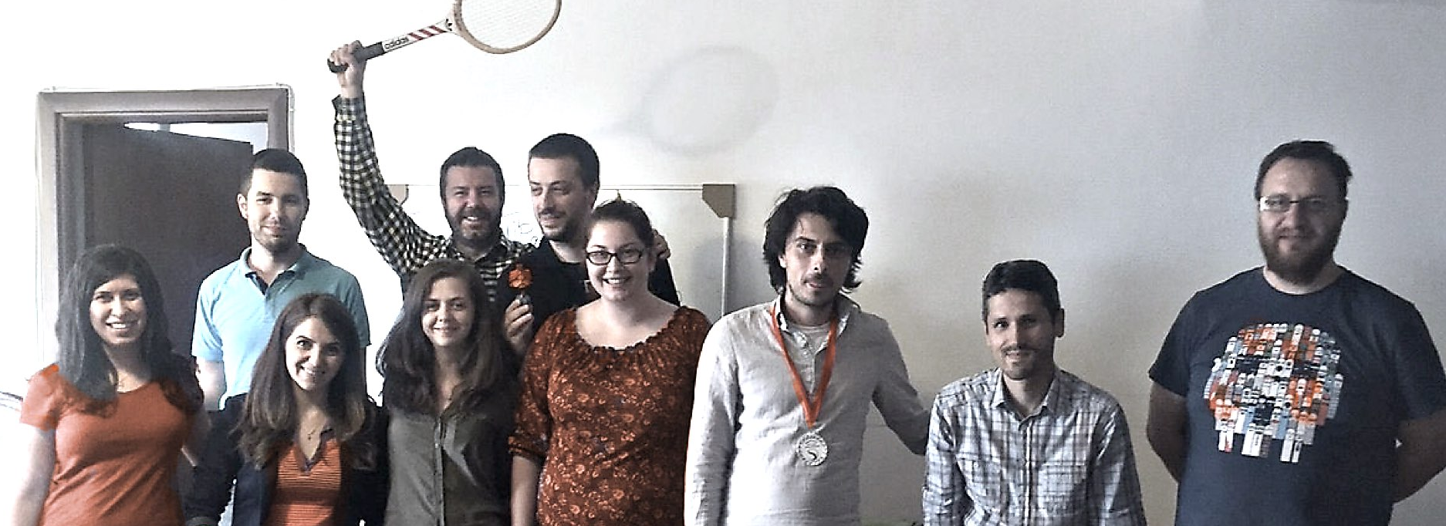
From Humble Beginnings…
$1.249B
Annual Recurring Revenue
10,850+
Total Customers
5,100+
Go-to-market partners
2M+
Community members
…to the Leader of Enterprise Automation
As of Apr 30, 2023
Notes:
We’ve talked about the UiPath Automation Platform lets also talk a little about UiPath as a company.
We started off as a small startup in Romania that took a big bet of the early category of RPA or Robotic Process Automation in 2015. Over the past few years we have grown into a trusted provider of broad enterprise automation.
We are a more than $1B revenue company with more than $2B in assets so we are someone you can trust will be around for the long haul.
We underpin the automation programs at >10K customers today including as I mentioned the largest automation programs in the world. Today, UiPath serves more than 60% of the Fortune Global 500 and 8 of the Fortune 10.
We have a large and extensive ecosystem of partners so you can be sure that your preferred integrators have the skills to help you get started
We have the largest automation ecosystem providing every type of expertise and support you’ll need with more 2M+ developers and an extensive academy and training program to help your own teams get started fast
Bottom line: UiPath is a trusted provider and you will never lack the partnership, support, and expertise you need to ensure your automation success.

Slide 13
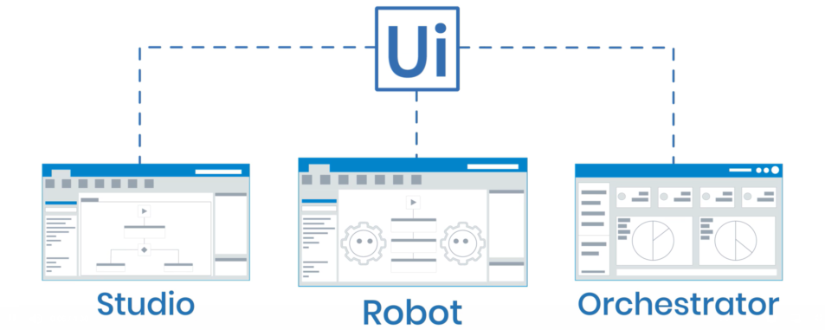
Basic Building Blocks of UiPath
UiPath Studio- It is a platform to create automation bots. It encompasses hundreds of activity templates and readymade components to drag and drop
UiPath Robot - They run the automation that is created using UiPath studio
UiPath Orchestrator - It is a centralized robot management dashboard where you can easily deploy, secure, and manage your UiPath Robots at scale

Slide 14
Various Kinds of Automaton Using RPA Tool(UiPath)
Types of RPA
There are 3 major types of robotic process automation: attended automation, unattended automation, and hybrid RPA.
Attended Automation - This type of bot resides on the user’s machine and is usually invoked by the user. Attended automation is best suited for tasks that are triggered by user Manually. Also Suitable where human interventions are required.
Unattended Automation -These bots are like batch processes on the cloud and data processing tasks are completed without Human Interventions. Unattended automation is ideal for reducing the work of back-office employees. Unattended automation can be launched in the following ways: data input in a specified location, bot initiated, orchestrator initiated, and specified intervals.
Hybrid RPA- In this type of RPA, attended and unattended RPA boys are combined so as to provide automation for both back and front office activities. “Required when Human in Loop is required”

Slide 15

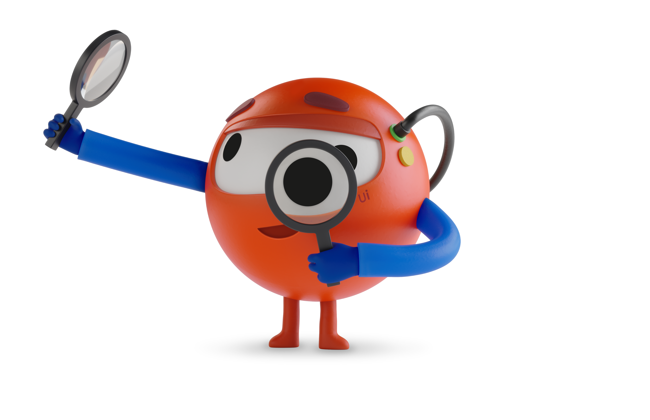
The unique benefits of automation
Works like a human does
Can take on a wide number of tasks and processes across your enterprise—reliably and without application changes
Fastest time to value
Accelerated ROI and business results. 88% of UiPath deployments finish in 6 months or less
Accessible to all
Allows entire organization to build and deploy automations, from non-technical to expert users
Low total cost of ownership
The centralized management, measurement, governance, and security you demand
Notes:
So why has automation as an approach taken off and become a strategic platform. There are really 4 differentiating factors that set automation apart from other approaches
1. It works like a human does – We talked about the impact of a shortage of people on your bottom line. Automation lets you create a digital workforce that can do real work like a person can. This means automation can take on a wide number of tasks and processes across your enterprise—reliably and without application changes.
2. Fastest time to value – Automation delivers real business value fast. Individual processes and tasks can be automated in days and weeks not months and years, resulting in accelerated ROI and business results. Gartner peer reviews data shows that 88% of entire UiPath deployments finish in 6 months or less which automate many processes.
3. Accessible to all – Automation allows entire organization to build and deploy automations, from non-technical to expert users. Citizen developers can be successful, with simple ways to build automations operating within guarrails established by the business on what they are allowed to do. Professional developers have the depth of capability to deliver team projects at high quality.
4. Low total cost of ownership – Automation includes the centralized management, measurement, governance, and security you demand to run large programs at the fraction of the cost of other technologies.

Slide 16
Important Links to Follow
Important links of UiPath
UiPath Academy - Learning Academy of UiPath.
Forum.uipath.com/- Lots of help and support from other Community Members
UiPath Marketplace - UiPath Marketplace to get online library of reusable RPA components
UiPath certification - UiPath Certifications for All RPA Roles
Contact Technical Support- For any questions or technical issues while using UiPath products
Community Orchestrator - Community UiPath Orchestrator Services
Chatbot.uipath - Portal to manage all your Chatbots connections
uipath.onlinetests.app - Practice Portal for certification
docs.uipath - UiPath Documentation Portal

Slide 17
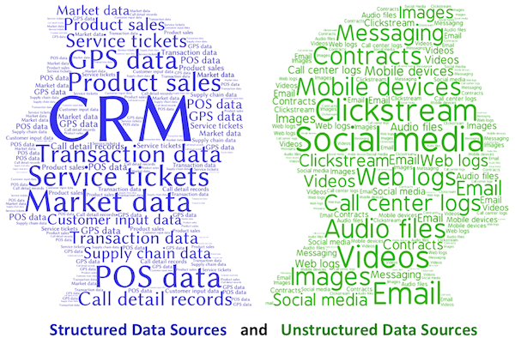
The BIGGER Problem…
80 % of Data Produced out of Digital System is
Unstructured

Slide 18

The AI Powered RPA…
A classic RPA bot copies human action, whereas AI simulates human intelligence through machines. By convention, AI-powered RPA is superior to traditional rules-based structured data automation with the use of technologies such as Optical Character Recognition (OCR), Text Analysis and ML, improving workplace experience.
It widens the application of RPA to more knowledge-based work, such as extracting information from unstructured sources and enhancing decision-making. Cognitive agents have a self-learning capability that enables them to act and learn from experience, from humans, and even on their own, thereby developing the ability to interact with their environment.
Simply put, traditional automation is process-driven, and AI and ML-powered RPA is data-driven.

Slide 19
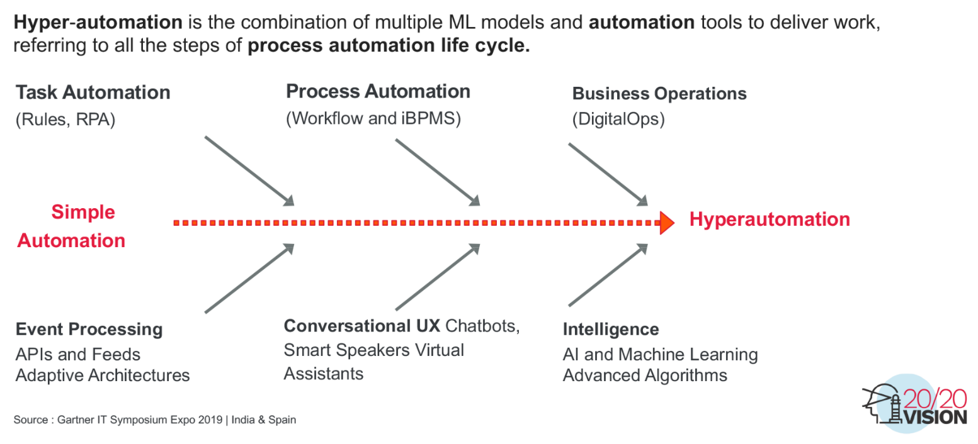
What is Hyper-Automation…

Slide 20
Is RPA still relevant in 2024?
The short answer? Yes!
RPA is still a useful automation tool. It deploys software robots to perform front and back-office tasks. Of course, a lot of enterprises are taking RPA to the next level and finding new ways to achieve total digital transformation.
RPA is well-suited for handling a lot of repetitive tasks like you’d see in administration. But by sweeping RPA together with AI and making it more accessible to citizen developers, businesses will get a lot more out of it – and that’s what we’re seeing in future automation trends.
Notes:
Will RPA become obsolete?
RPA is going to evolve from standalone RPA platform solutions to broader platform-play offerings including BPM, intelligent document processing (IDP) and more. AI automation will include more unattended automation that doesn’t require a human-in-the-loop (HITL). It’s also going to be more accessible to non-technical business users through low- or no-code tools.
Where does RPA fit in with other emerging technologies?
“The consolidation of BPM, RPA and IDP into a single vendor or platform model is part of a broader trend in business automation, aiming to provide a more holistic and efficient approach to managing and optimizing business processes and customer interactions.”
Greg Walker, Product marketing manager, SS&C Blue Prism
General enthusiasm for Generative IA in 2023 will bring focus on the automation approach. The potential for automation with AI and Gen AI is now exponential in any company.RPA, IA and Gen AI COE will continue to develop, with a strong executive focus on the business transformation and the scalability of the solutions.
Julien Fest, Intelligent automation offering lead, Avanade, LinkedIn

Slide 21
Will generative AI replace intelligent process automation?
Generative AI (Gen AI) and Intelligent Automation (IA) are indeed complementary technologies. Gen AI excels at generating insights and creating content, while IA focuses on executing tasks, managing workflows, and orchestrating resources based on those insights.
To put it simply:
Gen AI: Generates actionable insights and creates original content.
IA: Executes tasks, manages workflows, and orchestrates resources based on the insights and content from Gen AI.
Together, they form a powerful combination that enhances efficiency and effectiveness in various business processes. Are you exploring how to integrate these technologies in your organization, or are you just curious about their interplay?
Notes:
Will RPA become obsolete?
RPA is going to evolve from standalone RPA platform solutions to broader platform-play offerings including BPM, intelligent document processing (IDP) and more. AI automation will include more unattended automation that doesn’t require a human-in-the-loop (HITL). It’s also going to be more accessible to non-technical business users through low- or no-code tools.
Where does RPA fit in with other emerging technologies?
“The consolidation of BPM, RPA and IDP into a single vendor or platform model is part of a broader trend in business automation, aiming to provide a more holistic and efficient approach to managing and optimizing business processes and customer interactions.”
Greg Walker, Product marketing manager, SS&C Blue Prism
General enthusiasm for Generative IA in 2023 will bring focus on the automation approach. The potential for automation with AI and Gen AI is now exponential in any company.RPA, IA and Gen AI COE will continue to develop, with a strong executive focus on the business transformation and the scalability of the solutions.
Julien Fest, Intelligent automation offering lead, Avanade, LinkedIn

Slide 22
Will generative AI replace intelligent process automation?
Generative AI (Gen AI) and Intelligent Automation (IA) are indeed complementary technologies. Gen AI excels at generating insights and creating content, while IA focuses on executing tasks, managing workflows, and orchestrating resources based on those insights.
To put it simply:
Gen AI: Generates actionable insights and creates original content.
IA: Executes tasks, manages workflows, and orchestrates resources based on the insights and content from Gen AI.
Together, they form a powerful combination that enhances efficiency and effectiveness in various business processes. Are you exploring how to integrate these technologies in your organization, or are you just curious about their interplay?
Notes:
Will RPA become obsolete?
RPA is going to evolve from standalone RPA platform solutions to broader platform-play offerings including BPM, intelligent document processing (IDP) and more. AI automation will include more unattended automation that doesn’t require a human-in-the-loop (HITL). It’s also going to be more accessible to non-technical business users through low- or no-code tools.
Where does RPA fit in with other emerging technologies?
“The consolidation of BPM, RPA and IDP into a single vendor or platform model is part of a broader trend in business automation, aiming to provide a more holistic and efficient approach to managing and optimizing business processes and customer interactions.”
Greg Walker, Product marketing manager, SS&C Blue Prism
General enthusiasm for Generative IA in 2023 will bring focus on the automation approach. The potential for automation with AI and Gen AI is now exponential in any company.RPA, IA and Gen AI COE will continue to develop, with a strong executive focus on the business transformation and the scalability of the solutions.
Julien Fest, Intelligent automation offering lead, Avanade, LinkedIn

Slide 23
AI + RPA: Enabling End-to-End Automation(Use Case Example)
End-to-end automation is key to providing the self-service options that so many customers want. Consider how opening a new bank account online can be fully automated with the help of RPA and AI, resulting in satisfied customers and money-saving efficiencies for the bank.
Our customer wants to open a new bank account online. The chatbot verifies the type of account the customer wants (a business account), and provides a link to the relevant form. The filled-out form is submitted, and handed off to another robot who kicks off the process to open a new account. The robot does back-end tasks such as checking the customer credit score and running a “know your customer” verification process on Google and social networks.
Next, a smart OCR robot analyzes the scanned documents the customer uploaded along with the new account form. It identifies a discrepancy in the customer name as it appears on the form and on her driver’s license. This exception is sent for human adjudication. The agent confirms that Helen Green and Helen Ann Green are indeed the same person, because their Social Security Number is identical. Based on human input, the robot learns how to respond to similar situations in the future.
The robot continues to validate the uploaded documents using text analytics and natural language processing to interpret and categorize key data points from within the free text.
Once all data is in order, the robot executes the set of tasks required to set up the new business account, interfacing with the bank’s various back end systems. If the customer’s data meets bank requirements, the robot automatically sends an email to the customer with a warm welcome message, account information, and access credentials.
Finally, the robot reports back to the robotic control room with mission accomplished.

Slide 24
UiPath Set Up
Hands On Session
Trainer Will help to install UiPath Community Edition
References -
https://docs.uipath.com/installation-and-upgrade/docs/studio-install-studio

